Slide 1
Eva P. Stitt, PhD, BHIT3
Refugee Behavioral Health State Coordinator

Slide 2
Virginia Refugee Healing Partnership
Refugees are people who have been forced to flee their country or place of origin due to a well-founded fear of persecution for reasons of race, religion, nationality, political opinion, or membership in a particular social group.
2,000 refugees annually from around the world
Notes:
Title VI of the US Civil Rights Act of 1964: Section 601 of the Civil Rights Act of 1964 prohibits discrimination on the basis of race, color, and national origin in programs and activities receiving federal financial assistance (US DOJ, Civil Rights Division).
Executive Order 13166: Improving Access to Services for Persons with Limited English Proficiency: “Each agency should create a clearly written plan with explicit steps that they will take to ensure that meaningful access is provided to all LEP participants of federally funded programs”
CLAS Guidelines: Formulated by the Department of Health and Human Services, Office of Minority Health. Goal is to advance health equity, improve quality, and help eliminate health care disparities by establishing a blueprint for health and healthcare organizations.
Language Access (PM 02-08) Policy: "No person will be denied equal access to county services based on his/her inability, or limited ability, to communicate in the English language."

Slide 3
Refugee Determination and Processing
Refugee Act of 1980
US President
US Congress
State Department
UNHCR
Federal Office of Refugee Resettlement
State Office of Refugee Resettlement
Refugee Resettlement by Local Agencies

Slide 4
Virginia Resettlement Sites

Slide 5
Consultative and Technical Supports
Capacity Building
Community-based Leadership
Pathways to Wellness
Mental Health
Trauma
Language access
Cultural Competence
Direct Service Agencies
Behavioral Health Care Providers and Clinicians
Behavioral Health Interpreters
Stakeholders

Slide 6
Diversity, Literacy, & Workforce

Slide 7
Limited English Proficiency
Speak
Read
write
Understand

Slide 8
Interpreter Training

Slide 9
Organizational Chart
VOLUNTEERS

Slide 10
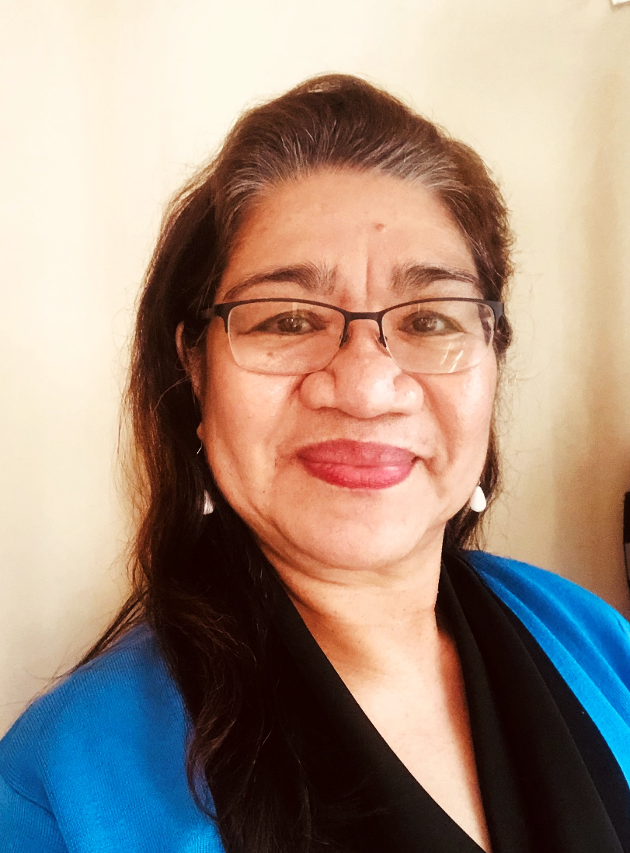
Thank you.
Eva P. Stitt, PhD, BHIT3
vrhp@dbhds.Virginia.gov

