Slide 1
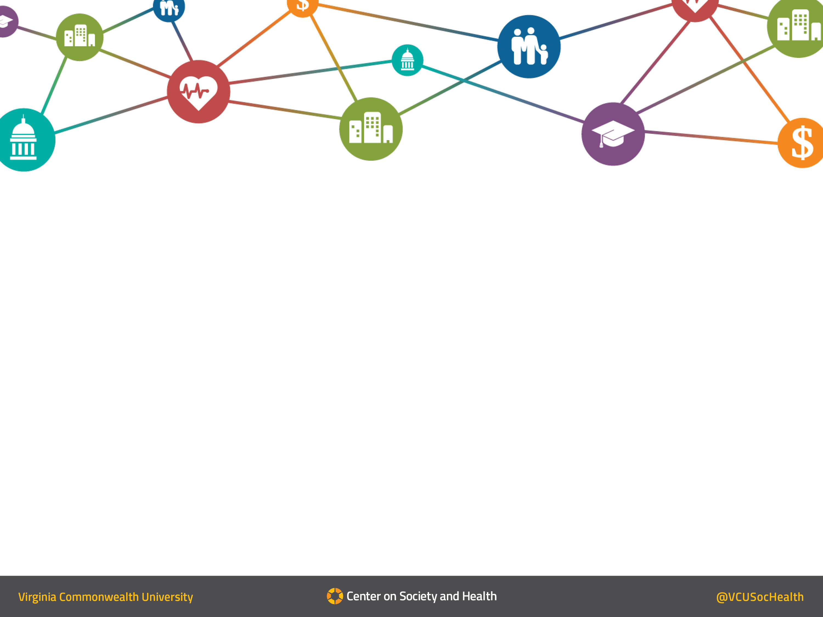
Behavioral Health Index -2 Results
Derek A. Chapman, PhD
Interim Director, VCU Center on Society and Health
Associate Professor, Division of Epidemiology,
Department of Family Medicine and Population Health
August 2021

Slide 2

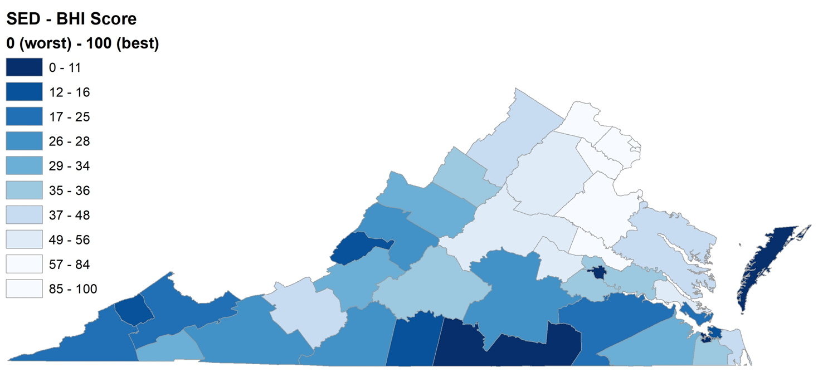
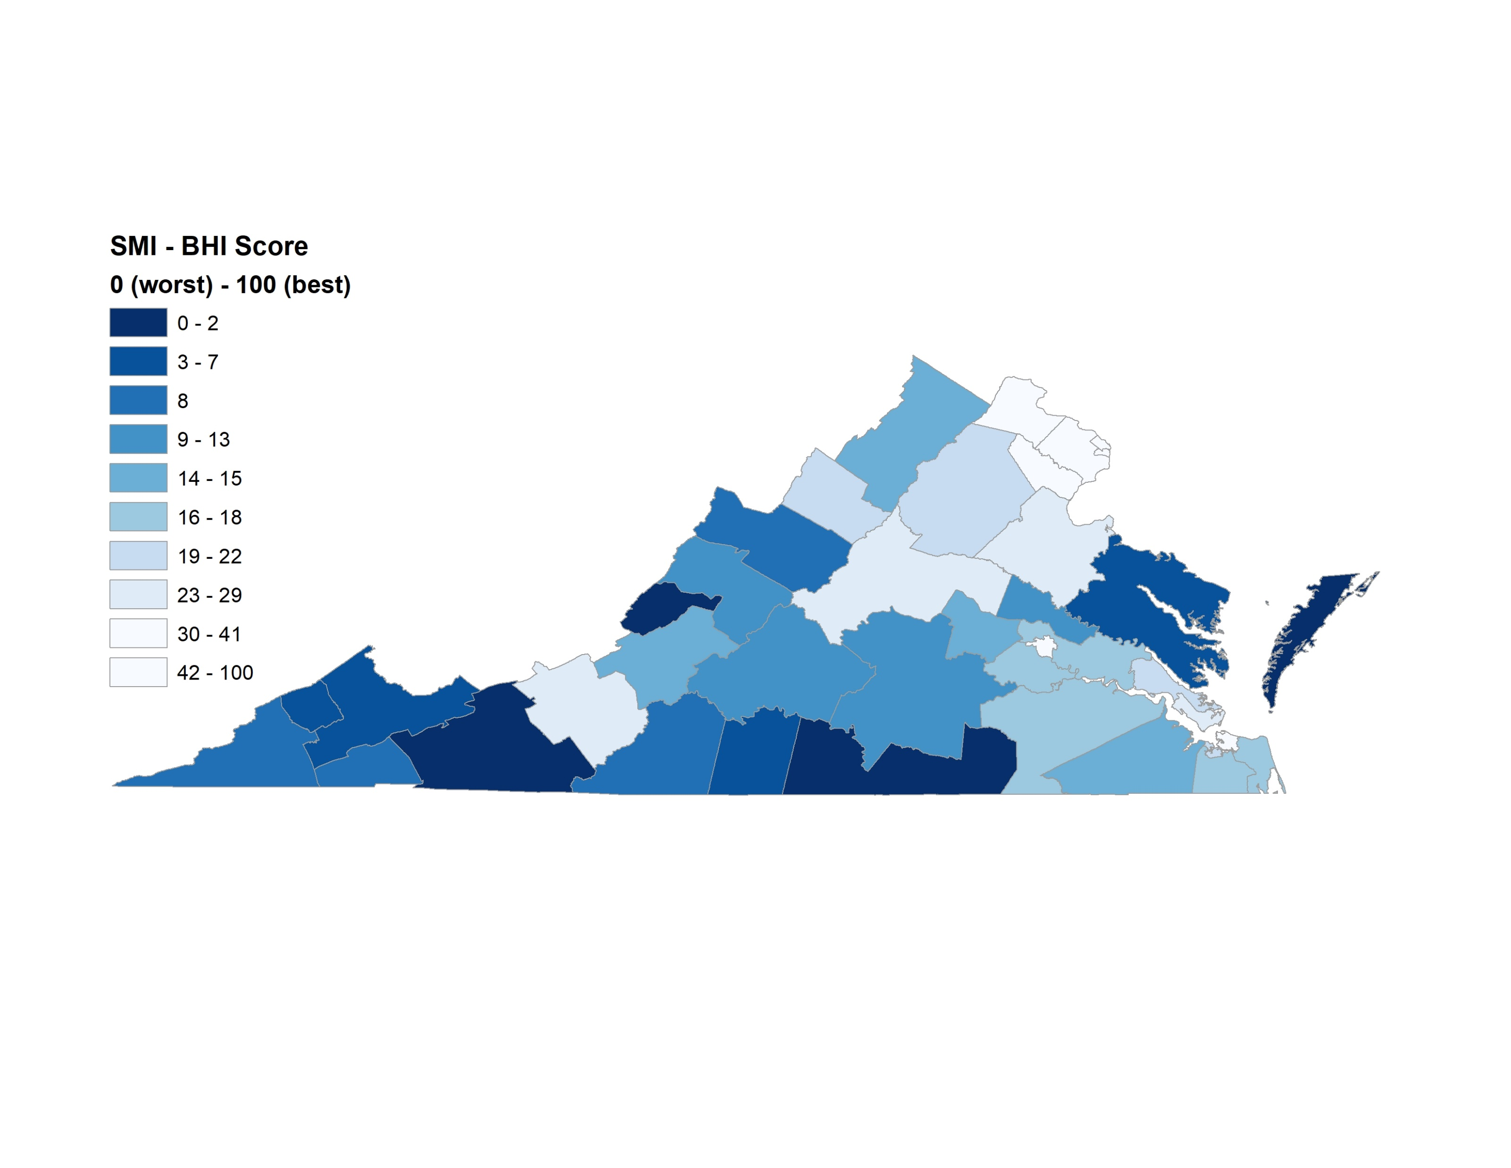
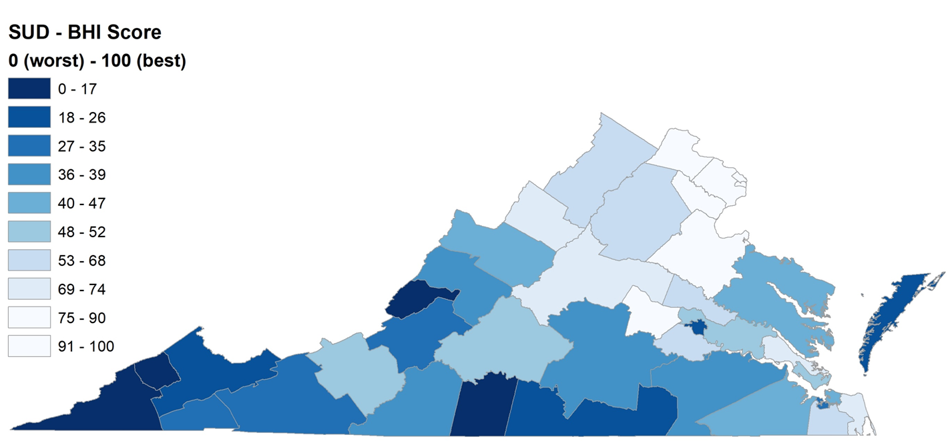
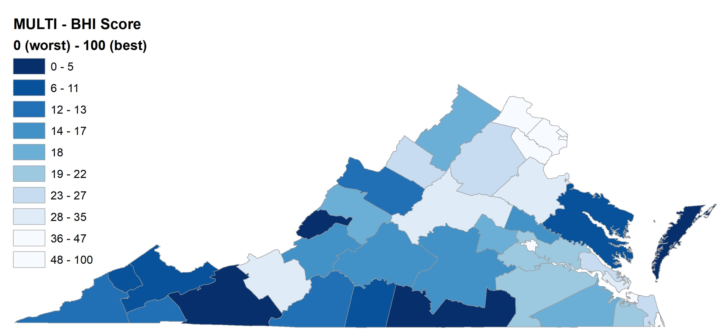
Behavioral Health Index (BHI) Scores by Community Service Board (CSB)- Overview
SED
SMI
SUD
SED, SMI, SUD

Slide 3
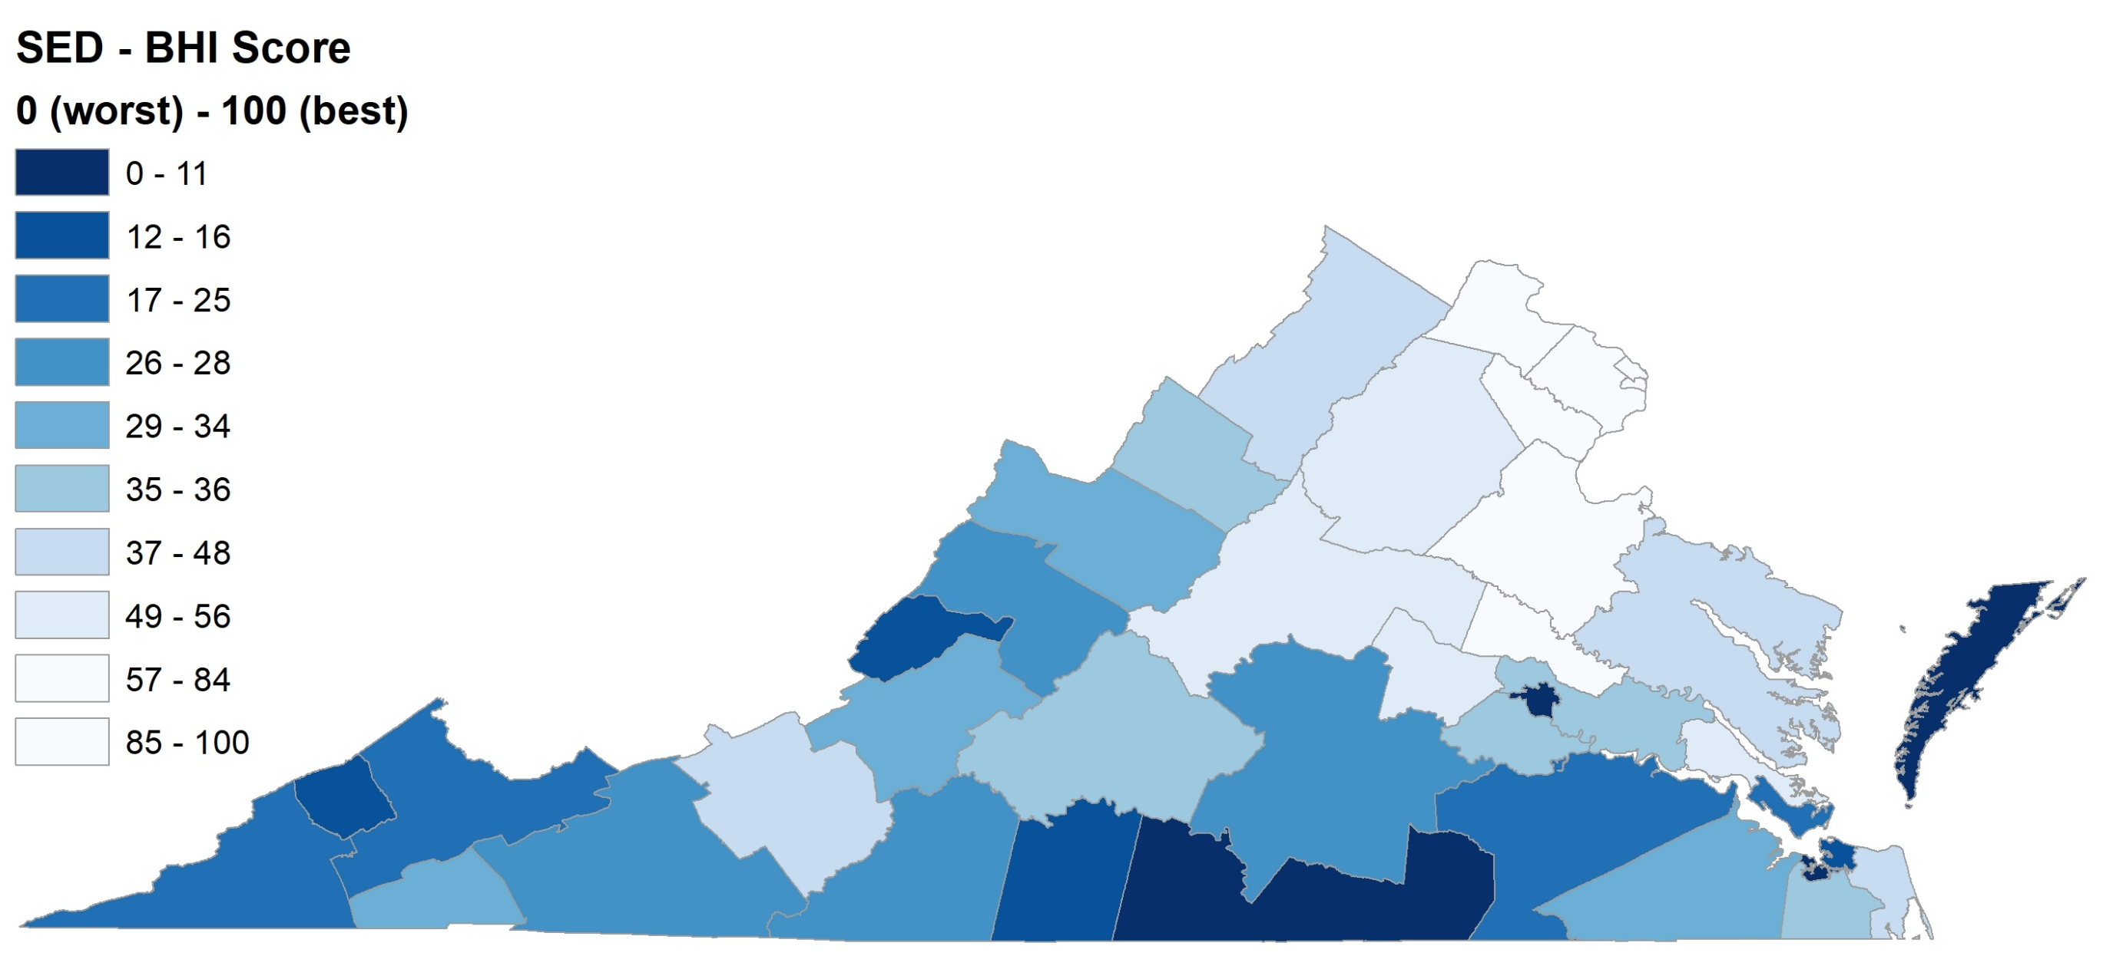
Behavioral Health Index (BHI) Scores for
Severe Emotional Disturbance (SED) by Community Service Board (CSB)

Slide 4
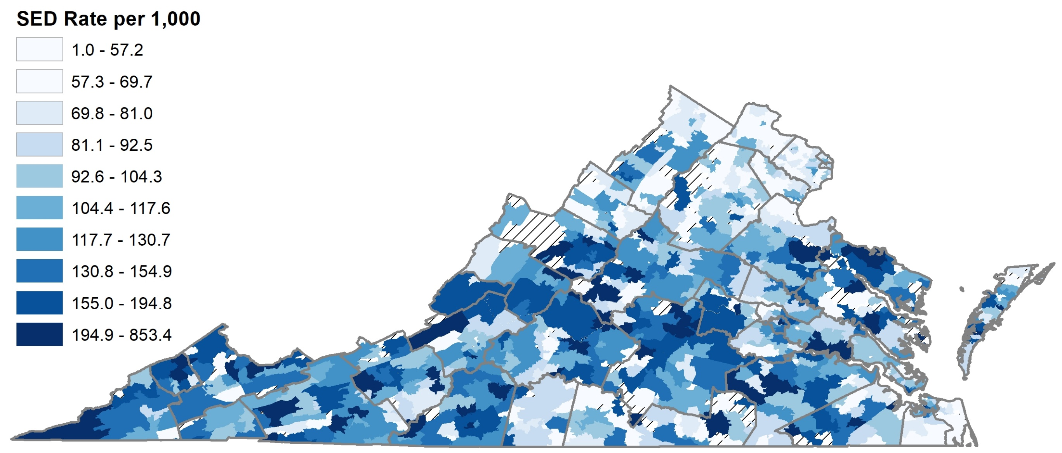
Severe Emotional Disturbance (SED) Prevalence by ZCTA, 8-17yrs

Slide 5
Behavioral Health Index (BHI) Scores for
Serious Mental Illness (SMI) by Community Service Board (CSB)

Slide 6
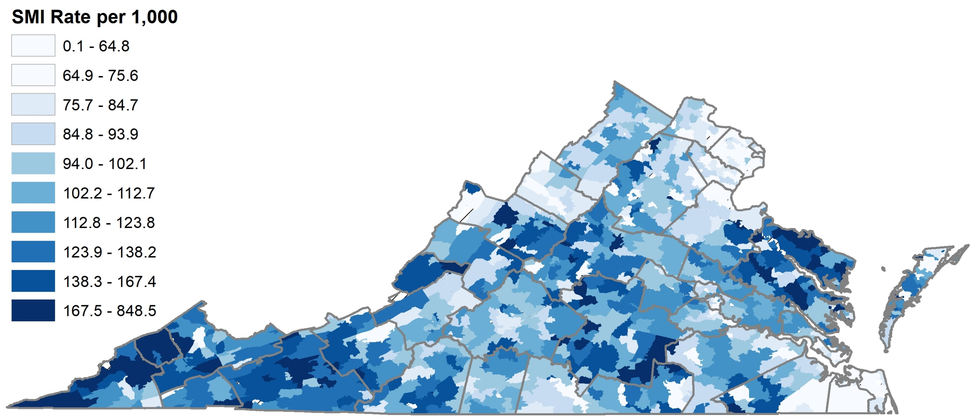
Serious Mental Illness (SMI) Prevalence by ZCTA, 18+ yrs

Slide 7
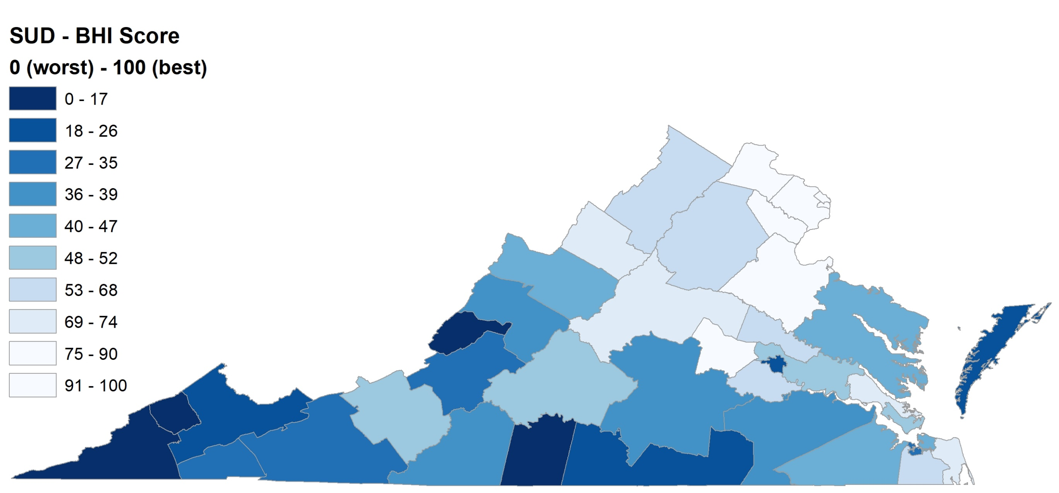
Behavioral Health Index (BHI) Scores for
Substance Use Disorder (SUD) by Community Service Board (CSB)

Slide 8
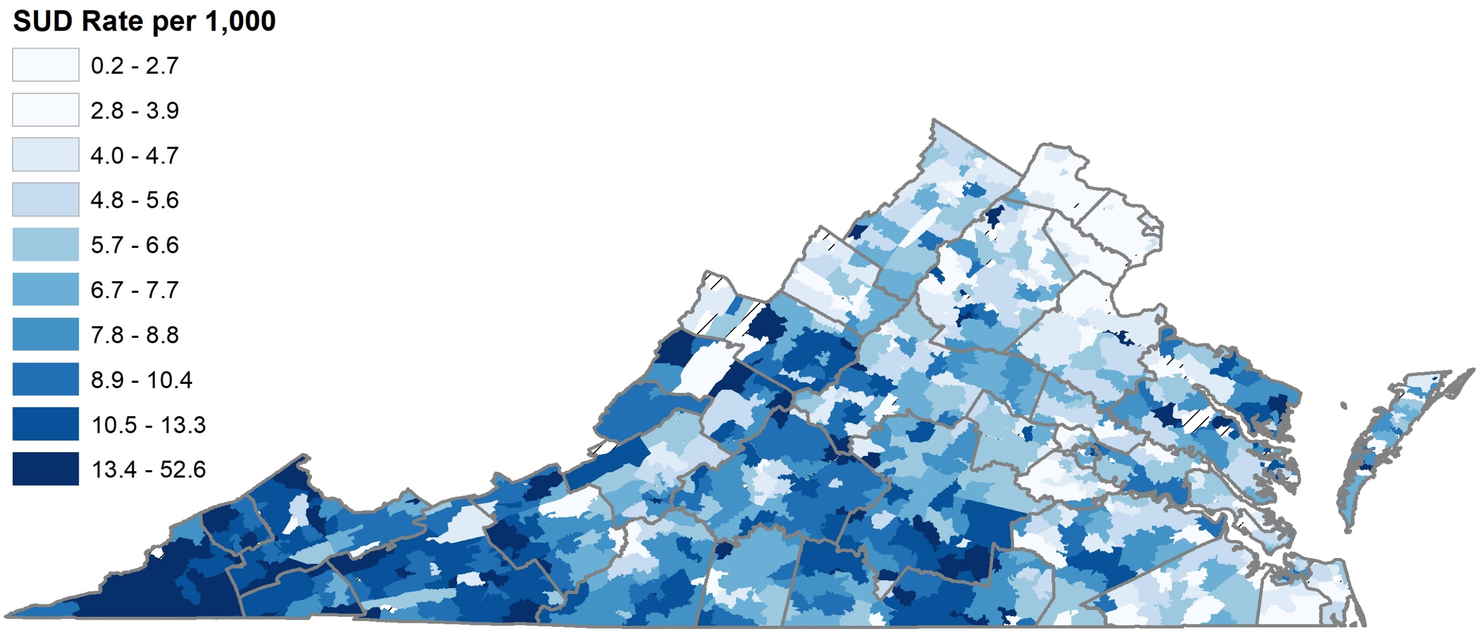
Substance Use Disorder (SUD) Prevalence by ZCTA, all ages

Slide 9

Behavioral Health Index (BHI) Scores for
SED, SMI, or SUD (MULTI) by Community Service Board (CSB)

Slide 10
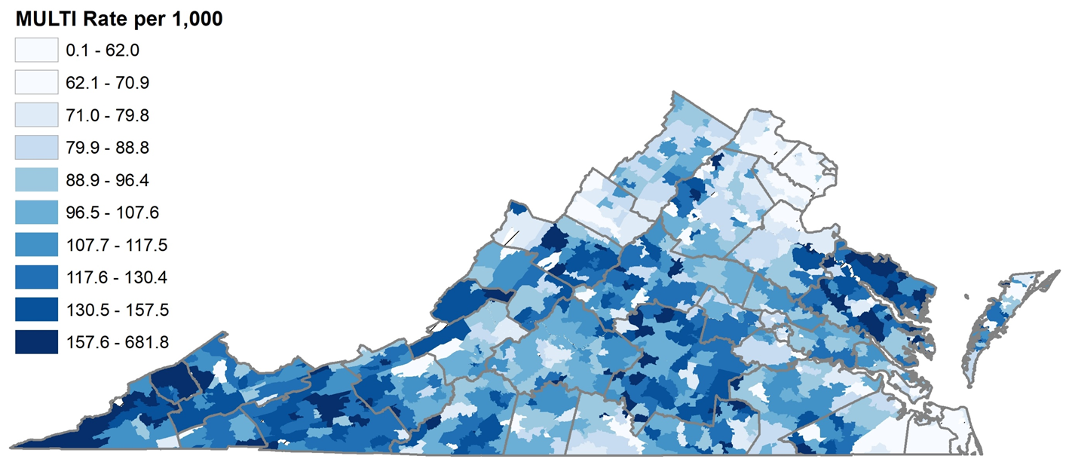
SED, SMI, or SUD (MULTI) Prevalence by ZCTA, all ages

Slide 11
Final index weights for SED, SMI, and SUD
RED= Positive correlation (HIGHER rates of outcome with higher indicator value)
BLUE= Negative correlation (LOWER rates of outcome with higher indicator value)

Slide 12

Contact information
Derek A. Chapman, PhD
Email: Derek.Chapman@vcuhealth.org
www.societyhealth.vcu.edu

